Slide 1
Target Tracking
Emulator Architecture
Couch
Input motion trace
UDP receive
Couch Feedback
Compensation algorithm
Updated positions
Couch move
KIM noise (optional)
Couch error (optional)
Couch positions
Tracking latency
Latency = 0-max ms
Motion plot in real-time
UDP send

Slide 2
Real-world couch tracking system
Algorithm/Software
Things are difficult to 100% simulated:
Real-world physics
Motor non-linear behaviors
Load mass, friction, motor response speed etc.
Other latencies
Tracking measurement time
Computation duration
Communication (UDP)
Real-time tracking
Motion compensation
Hardware
Goal:
- Develop an emulator that has identical compensation algorithm,
also with dumper control that would give us a close enough simulation
towards real-world system.
- Identify critical parameters/conditions that would fail the compensation.
Motor limitation
Hardware latency
Load, friction etc

Slide 3
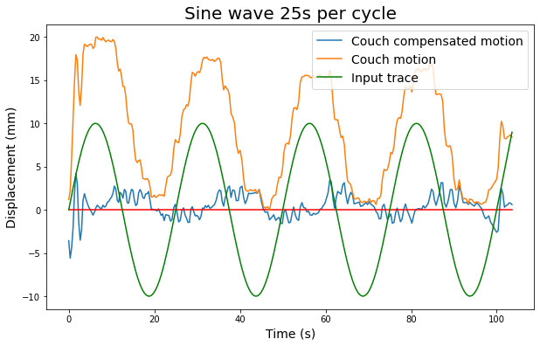
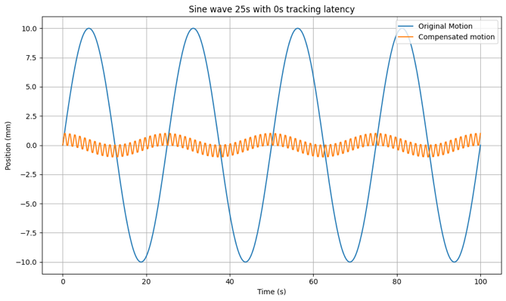
Compensation Logic
Whether emulator has the identical compensation logic
Core compensation logic
Motor moves at opposite direction
Compensated motion was around 0mm
Notes:
Result analysis consistent signs

Slide 4
Compensation algorithm
1750739736063068 0.903322 40.4445 Move
1750739736063, Sent feedback: -0.903322
1750739736187159 -8.74993
1750739736387983 -9.64539
1750739736588429 -9.63266
1750739736787558 -9.61814
1750739736916691 -8.74993 49.1944 Move
1750739736916, Sent feedback: 8.74993
1750739736987117 -9.60632
1750739737187279 -0.850088
1750739737388194 -0.847937
1750739737587646 -0.845441
1750739737788011 -9.60632 58.8007 Move
1750739737788, Sent feedback: 9.60632
1750739737788435 -0.838568
1750739737858609 -0.838568 59.6393 Move
1750739737858, Sent feedback: 0.838568
1750739737987661 -0.826811
1750739738056940 -0.826811 60.4661 Move
1750739738057, Sent feedback: 0.826811
Motor moves at opposite direction to achieve compensation
Motor moving time is simulated (Moving distance/velocity)
Measurements are skipped when motor is still moving,
motor always react to most recent data

Slide 5
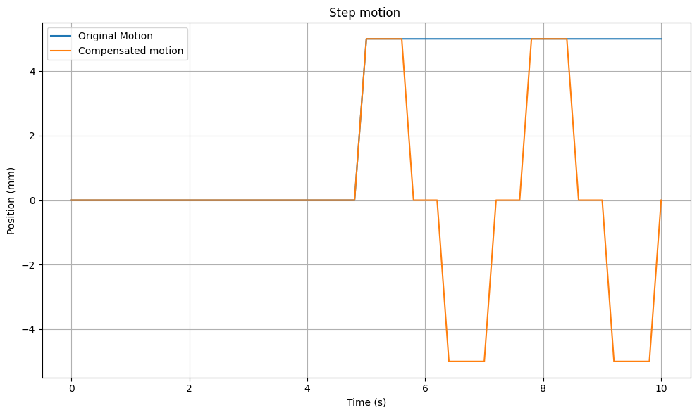
1750820364112, Sent feedback: -0
1750820364312443 5
1750820364511862 5
1750820364712518 5
1750820364729607 5 45 Move
1750820364729, Sent feedback: -5
1750820364911421 5
1750820365111097 0
1750820365311401 0
1750820365328921 5 40 Move
1750820365329, Sent feedback: -5
1750820365511966 0
1750820365513084 0 40 Move
1750820365513, Sent feedback: -0
1750820365711706 -5
1750820365911348 -5
1750820366111781 -5
1750820366129239 -5 45 Move
1750820366129, Sent feedback: 5
1750820366311143 -5
1750820366511164 0
1750820366711967 0
1750820366728742 -5 50 Move
1750820366729, Sent feedback: 5

Slide 6
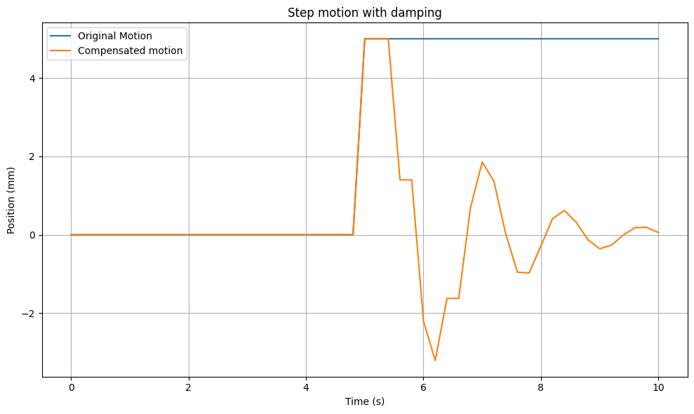
1750825319774097 5 46.4 Move
1750825319774, Sent feedback: -3.6
1750825319798094 5
1750825319997392 1.4
1750825320173836 5 42.8 Move
1750825320174, Sent feedback: -3.6
1750825320198263 1.4
1750825320304124 1.4 41.792 Move
1750825320304, Sent feedback: -1.008
1750825320399480 -2.2
1750825320565258 -2.2 43.376 Move
1750825320565, Sent feedback: 1.584
1750825320597717 -3.208
1750825320797979 -1.624
1750825320839191 -3.208 45.6858 Move
1750825320839, Sent feedback: 2.30976
1750825320999162 -1.624
1750825321121701 -1.624 46.855 Move
1750825321121, Sent feedback: 1.16928
1750825321198910 0.68576
1750825321251001 0.68576 46.3613 Move
1750825321251, Sent feedback: -0.493747
1750825321398262 1.85504
1750825321538118 1.85504 45.0257 Move
1750825321538, Sent feedback: -1.33563
1750825321598353 1.36129
1750825321701195 1.36129 44.0455 Move
1750825321701, Sent feedback: -0.980131

Slide 7
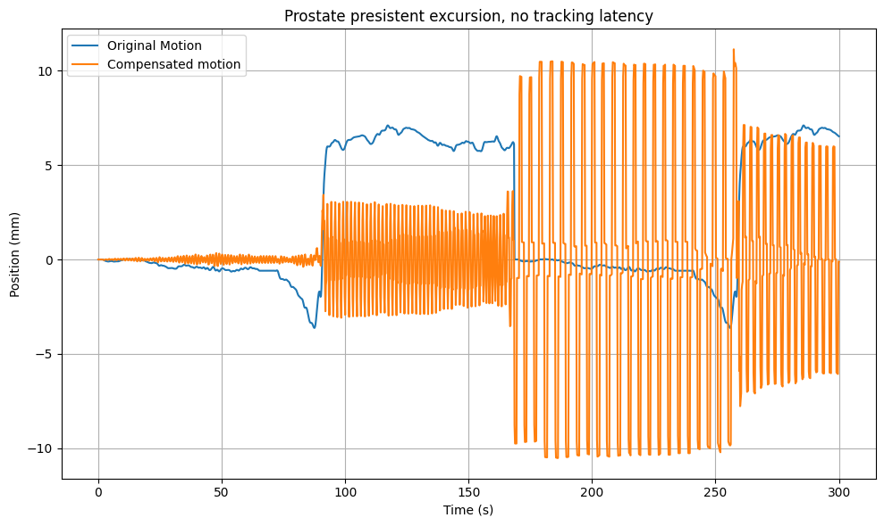
Emulator result with identical compensation algorithm
Compensation algorithm:
Naïve algorithm without tuned PID controller
Why oscillation?
Motor overshoot, corrects too much
Motor tries to correct again in opposite direction
Overshoot again
End up: oscillation

Slide 8
In real-world | Emulator parameter | Description
Inertia | Smoothing factor 0.8 | Motor changes direction slower
Damping | Proportional gain (PID) 0.9 | Reduces responsiveness to small or fast changes
Friction | Deadband Filtering small motion 0.1~0.5mm | Prevents small oscillatory corrections (as they don’t overcome friction)
Limited acceleration | Model acceleration ramp (trapezoidal motion) | Simulates gradual velocity change (optional but realistic)
Motor latency | Lag = 0~50ms | Motor takes time to initiate

Slide 9
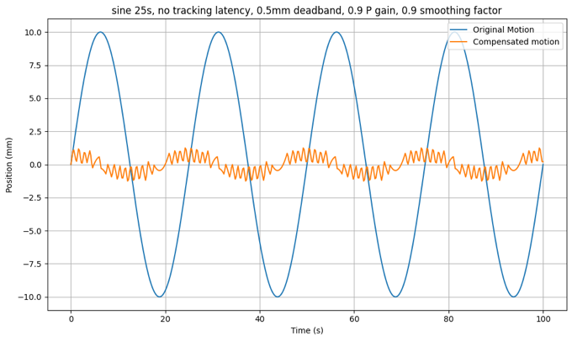
***Emulator needs to have identical compensation algorithm,
but also needs to simulate the impact of hardware

Slide 10
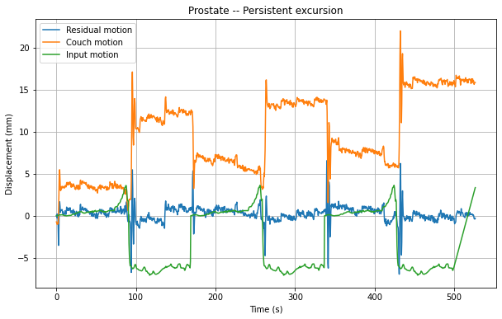
Couch tracking compensation performance on Prostate persistent excursion motion trace

Slide 11
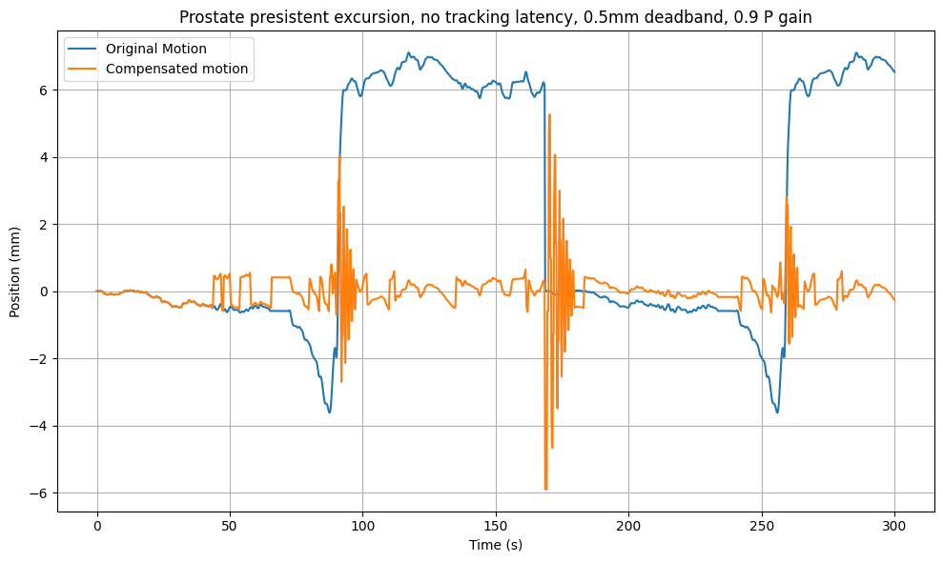
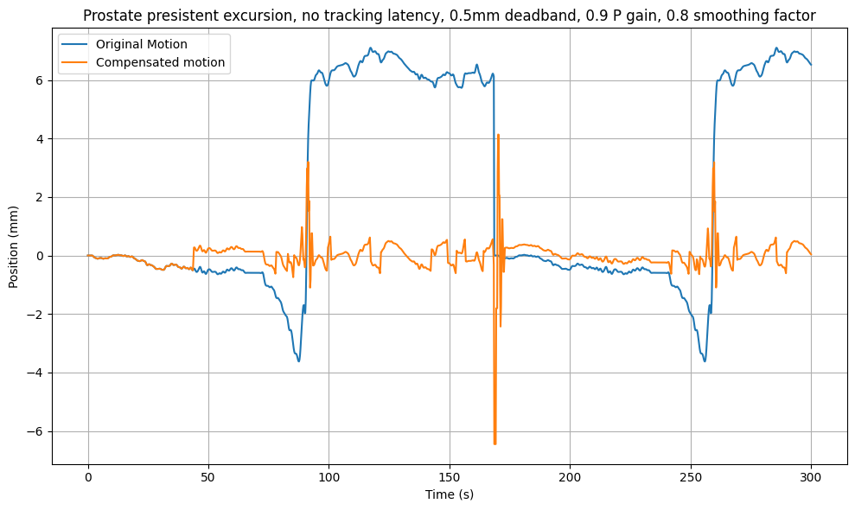
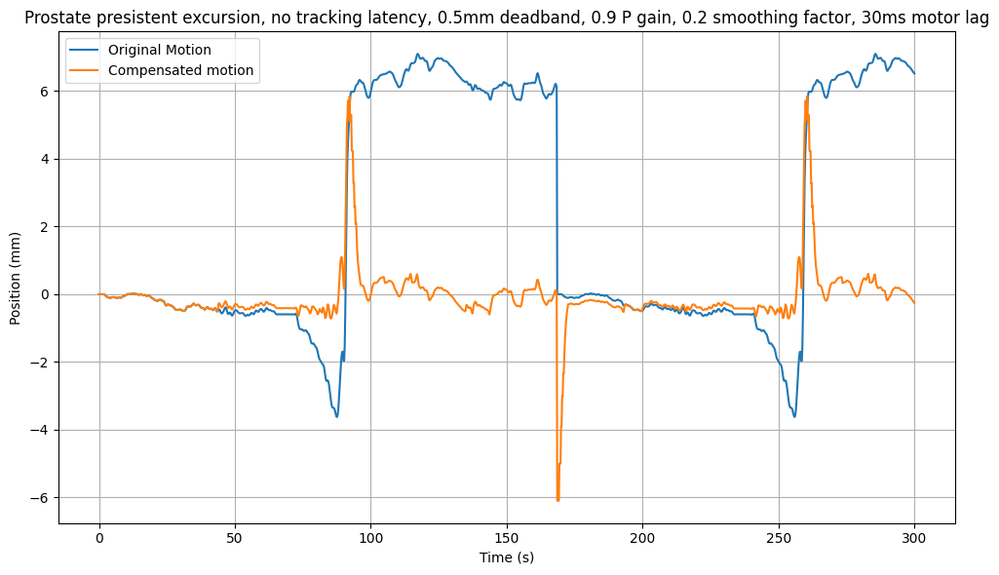

Slide 12
Why there’s an oscillation residual motion in compensated motion?
To obtain the compensation amount that motor should be moving, a deviation from isocenter needs to be detected first.
Hence a small lag always exists.
2. Target tracking sample frequency. A new position has happened but not yet being captured and sent to motor
Input = x(to) = A * sin(ωt), Compensation (with lag Δt) = -A * sin(ωt - φ)
Residual motion: X(to)+Xmotor​(tm)=A[sin(ωt)−sin(ωt−φ)]=2Asin(2φ​)cos(ωt−2φ​)
Latency = to-tm, greater the latency, higher residual motion

Slide 13
In Real-world, errors could comes from:
Motor error
Not able to run at full speed.
Time taken to change direction and accelerate to full speed, decelerate to 0mm/s
Not fast enough to response
Cannot response to small amount of changes (sub-mm or sub-cm changes)
Overshoot or undershoot which requires motor to not just correct for target motion but also itself
2. System latency
Tracking latency
Motor latency
Lag that is needed for deviation to appear and trigger motor to response
***(the natural of compensation algorithm unless we implement prediction model)
3. Tracking error
Depth camera, IEC algorithm, generate noise.
CONCLUSION:
Couch tracking works with tolerance. If system latency exceed the threshold,
motor responses to the incorrect positions which introduces more deviation from isocenter.
Developing emulator to see whether we can quantify such a threshold, and see impacts that other factors bring in.

Slide 14
Limiting factor | Resulting to | Reason | Potential solution
Latency | Phase lag | Motor lags behind, causing residual oscillation, or worse introduces bigger error | High measurement frequency, simplify steps to shorten latency, implement prediction model
Max motor velocity | Fail to compensate fast motion | Motor hardware limitation | Better motor
Max motor acceleration | Cannot response to fast change | Motor hardware limitation | Better motor
Command update rate (tracking and motor) | Resolution of data point | Some useful information could be be missed | Higher sample rate, better motor
Tracking accuracy | Error in measurement | Hardware limitation | Averaged on multiple frames

Slide 15
Emulator error:
The nature of emulator algorithm.
Time taken to send the signal and a response is generated by motor
Time taken to send the adjusted values back and updated the original motion

Slide 16
|---------------2-3ms------|
Data
UDP send
UDP receive
Motor response
UDP send
|--------------------------------------------------------------------------------------20ms ----
-----------
|----------------------------------------------------------------------------------------------------------
?
Motor response
Tracking
Data
UDP send
UDP receive

Slide 17
Motion Traces
(tumor type, patterns, frequency etc.)
Parameters:
Velocity, PID, latency etc.
Positional update
Target tracking
(Measurement tool)
Couch
Couch feedback
Performance evaluation (numerical)
Simulation logs
Result plotting (visual)

